Slide 1
Monsters vs Plumbers
The Game
By: Alison, Nick, and Zach

Slide 2
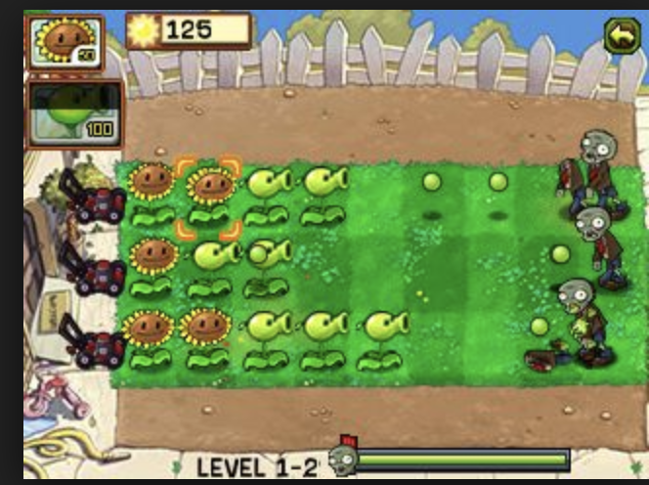
About The Project
Tower Defense Style Game
Modeled after Plants VS Zombies
Object of the Game: strategically place turrets to defend from oncoming enemies for as long as possible
“Plants vs Zombies Download Free.” Java Game for Mobile. Plants vs Zombies Free Download., java.mob.org/game/plants_vs_zombies.html.
Notes:
https://java.mob.org/game/plants_vs_zombies.html

Slide 3
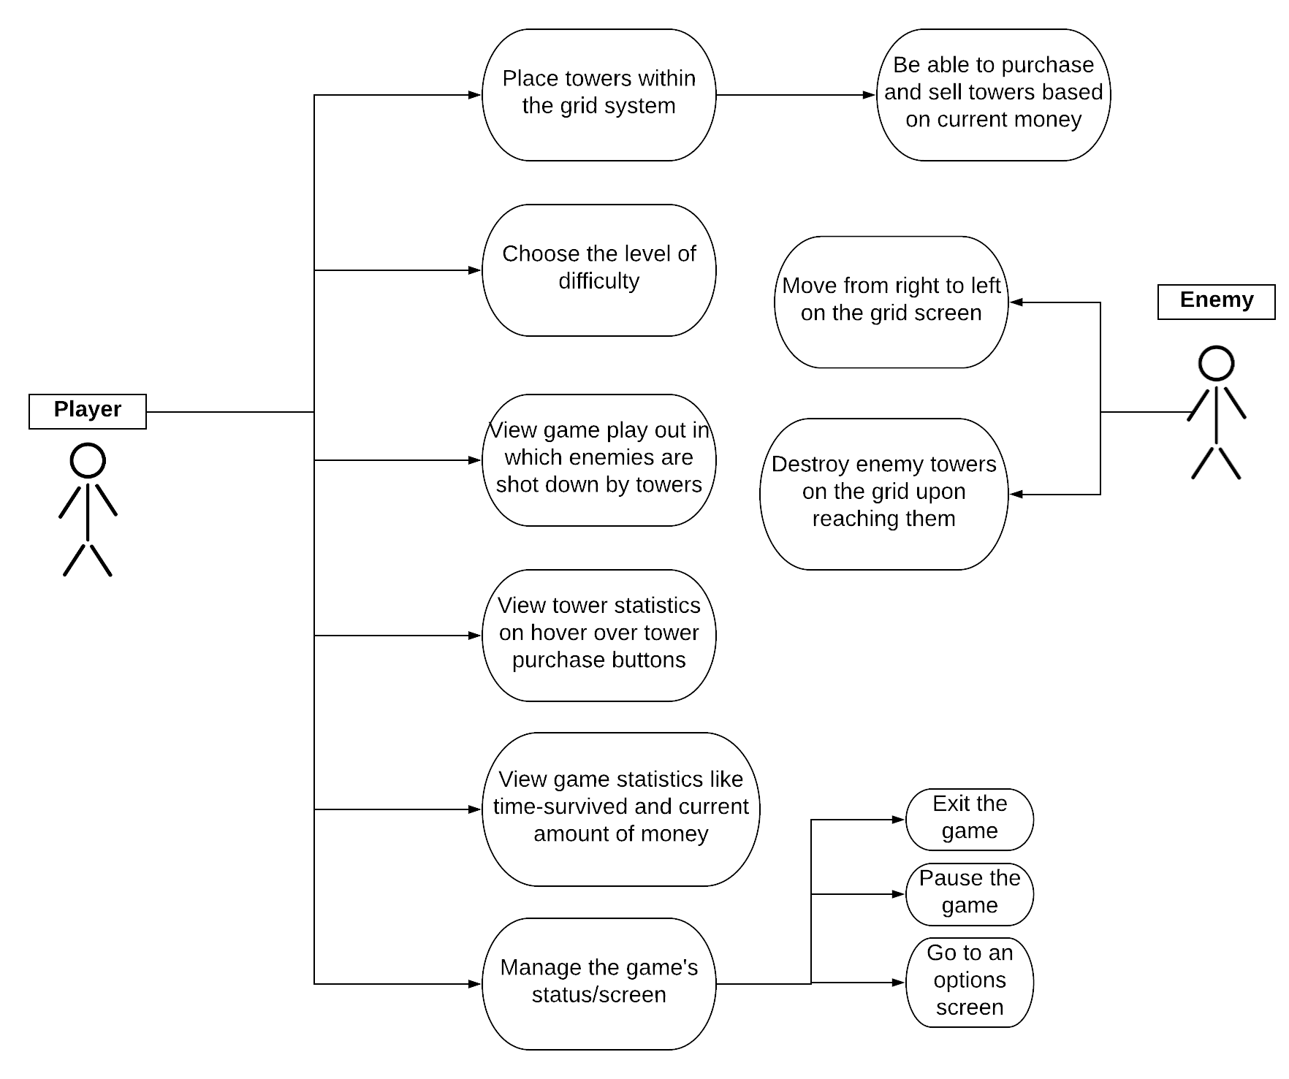
Use Case Diagram
Notes:
Describe what we want the player and enemy to be able to do essentially

Slide 4
Design
The game is displayed on a Board made up of different TileRows that each contain Tiles on which the user places Towers that fire Projectiles at the oncoming Enemies.
The Tile class then detects collisions between Towers, Projectiles, and Enemies
The MoneyHandler manages how much money they user can spend to buy more turrets
The SurvivalTimer lets the player know how long they have “survived” for
Player interacts with the game by placing Towers via mouse click

Slide 5
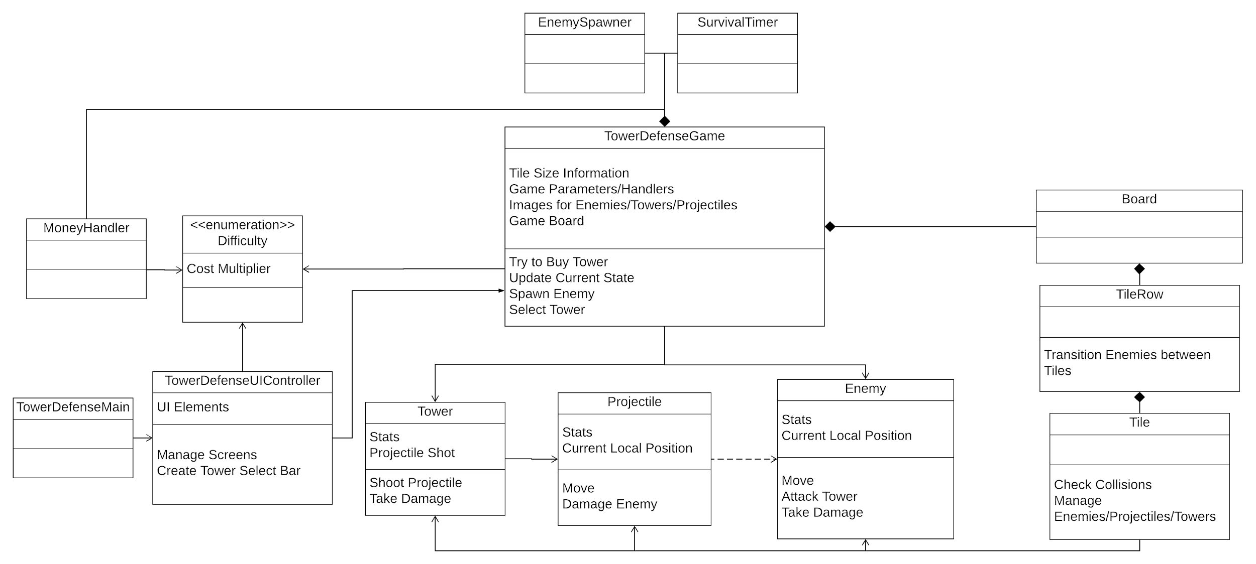
UML Diagram

Slide 6
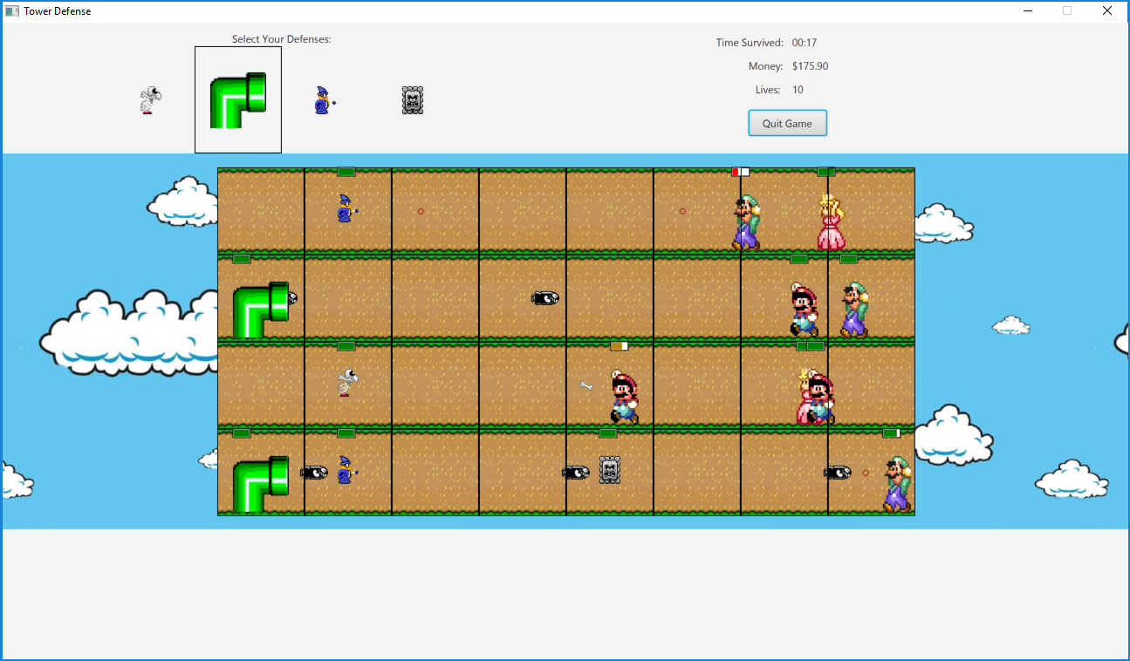
User Interface
Key Features:
Three-Layered Structure
Top: General Info
Middle: Game Screen
Bottom: Selected Tower Info (To Do)
Clear Tiles for Placing Towers
Mouse Interaction Only

Slide 7
DEMO!!

Slide 8
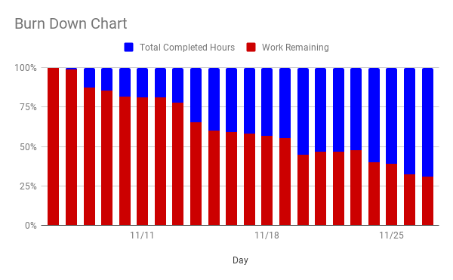
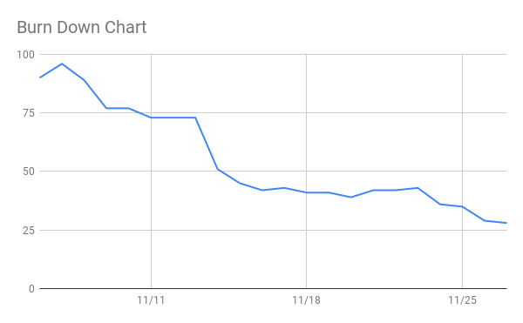
Scrum
Challenges:
Trello vs Excel
Organization of charts
Strengths:
Continual maintenance kept us on track
Easy to see what needs testing
Changes in Future:
Emphasize equal amounts of work within each sprint

Slide 9
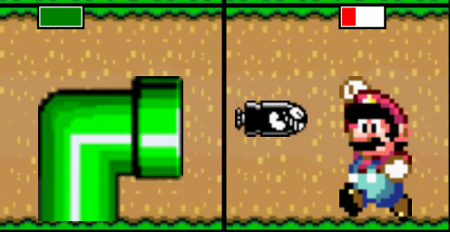
Scrum: User Stories
See the background (board) with tiles clearly shown
First established class structure: Board level down to Tile level
Create TowerDefenseUIController to connect the view to the back-end
See enemies spawning on the right, moving left
Create Enemy class as a template for all enemy types
Set up interaction between Enemy and Tile classes
Use the TowerDefenseUIController
Have the towers damage and eliminate the enemies
Create Tower and Projectile classes
Add Tile functionality to check for collisions

Slide 10
Strengths and Weaknesses
Strengths
We knew each other’s strengths so we could divide work up in the most efficient ways
Good team dynamic: we all got along really well
Weaknesses
Communication: staying on the same page
Issues with Git

Slide 11
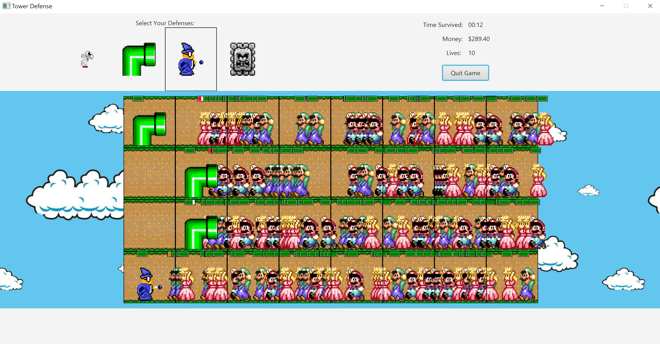
Problems we ran into
Bullets were backwards
Overlapping enemies spawning
Tile textures covering enemy textures
Teleporting enemies
Many different game variables to balance

Slide 12

What we would do with more time
More “towers” (monsters) with different functionalities
More enemies with different functionalities as well
Balancing money vs spawn rate better
Balancing boredom with being overwhelmed in spawn frequency better
“SNES - Super Mario World - Bowser.” The Spriters Resource, www.spriters-resource.com/snes/smarioworld/sheet/52778/.

Slide 13

What we learned
The value that regular UML updates brings in understanding our code
Necessity of continual testing
The ability to work simultaneously without face-to-face contact
Importance of organized branching in Git
“Our New Logo.” GitLab, 3 July 2015, about.gitlab.com/2015/07/03/our-new-logo/.

